Slide 1
Removal profiles for LGA80D

Slide 2
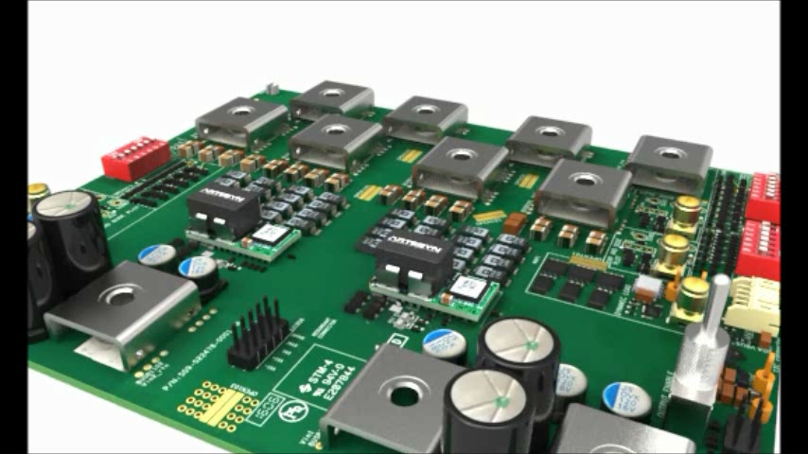
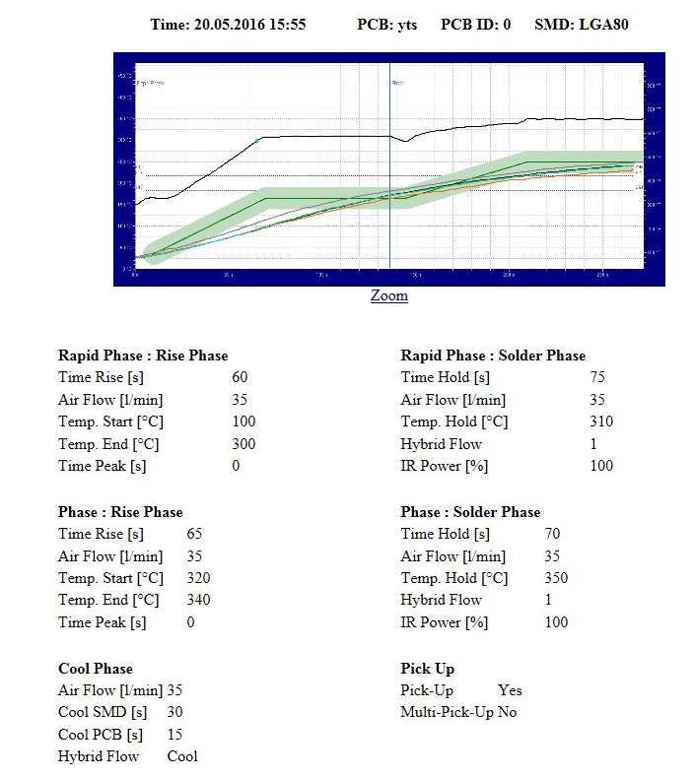
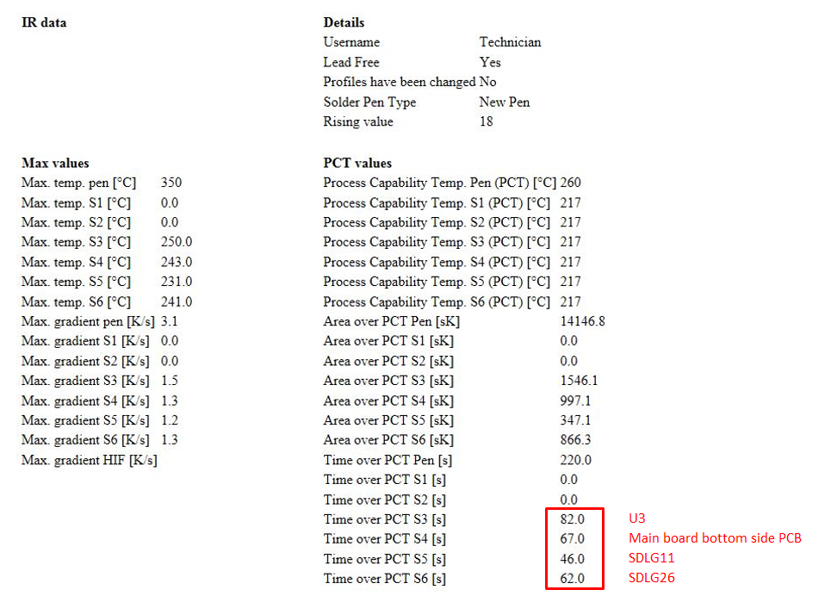
Removing the LGA80D
Using machine; Martin MaFi 438

Slide 3
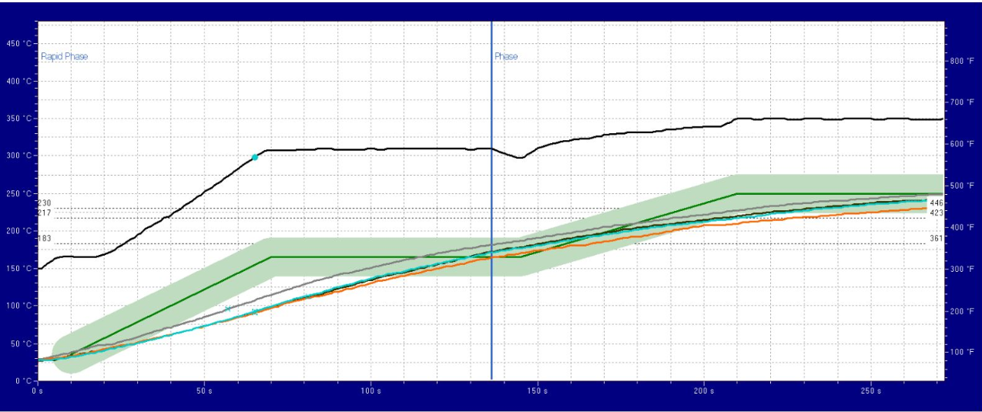
Temperature profiles.
Using machine; Martin MaFi 438

Slide 4
End of file.

